Slide 1

Importance of Information Technology in AI Product
Shanu Agrawal
Notes:
Introduce yourself, It is my pleasure to be here as keynote speaker, I am going to talk on importance of information technology in building successful AI product. First lets understand what is AI product

Slide 2
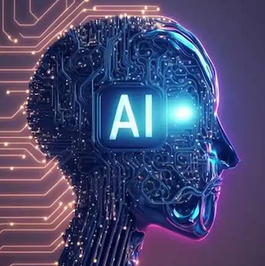
What is AI Product?
It is a software or hardware solution that utilizes AI algorithms to perform tasks that typically require human intelligence.
Recognizing Cat and dog images, driving, finding answer in document, Loan Default prediction
These products are designed to analyze vast amounts of data, recognize patterns, make predictions, and even learn from experience.
It can enhance decision-making, reduce human error, reduce repetitive tasks, and predict demand. This means more efficiency for working people and corporations.
Notes:
AI products leverage machine learning, deep learning, natural language processing, and other AI techniques to analyze data, make decisions, and execute actions. example of Spray Layout Design Parameters Whenever we get requirement from vehicle manufacturer need to convert them to manufacturing parameters how many hole, radius, plate thickness, spray angle and so one. And it requires lot of expertise and knowledge in product manufacturing design. Using the AI model, we can provide probable manufacturing parameters using the historical data. AI products also help in analyzing vast amount of data can creating insightful reports for example in supermarket just by showing how many items sold for each product on daily basis, which product group selling the most, using this they can Predict demand, reduce stockouts, and minimize overstock situations. Understand customer preferences, shopping patterns, and improve personalized marketing.

Slide 3
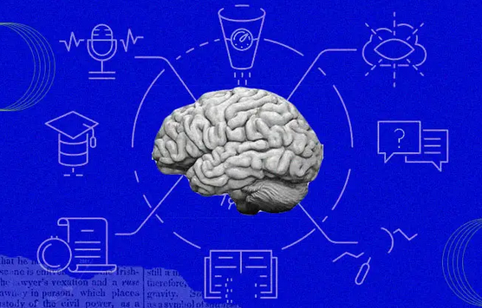
AI Products
Financial institutions are utilizing AI algorithms to detect fraudulent activities and make more accurate predictions in stock trading.
Entertainment industry, machine learning algorithms to suggest personalized content to users.
In healthcare sector, AI algorithms to detect anomalies in X-rays, MRIs, CT scans with high accuracy.
Social Media, Twitter uses AI to filter out hate speech and terroristic languages in tweets, personalized tweets
Notes:
And the most interesting thing is that AI is not domain/industry specific, its application can be everywhere. Beat Finance, beat healthcare, beat education, agriculture, social media.
This not only speeds up the diagnosis process but also helps doctors make more informed decisions
AI can also protect life of workers in risky jobs such as mining, firefighting and processing radioactive substances.

Slide 4
Beginning of AI
Most people think that AI is a recent scientific accomplishment. But its roots were laid down way back in the 1900’s.
1950 : Alan Turing’s paper called “Computing Machinery and Intelligence” starts with the question “Can machines think?”
1966 :Unimate, the first industrial robot in history
Eliza is the first natural language processing computer program designed between 1964 and 1966 at the MIT AI Laboratory by Joseph Weizenbaum
1997 – A computer beats human! IBM’s computer IBM Deep Blue defeated the world chess champion, Gary Kasparov, and became the first computer to beat a world chess champion.
Notes:
Due to the advancement's information technology, we see AI application everywhere. inUnimate was working with heated die casting machines. Its duty was simple but this duty was dangerous for workers to do and they could have hurt or lost their limbs if they carried the task. Therefore,using Unimate was more practical and safer. Besides, Unimate was able to carry the task quickly. Thanks to Unimate robots, General Motors have changed the automotive industry forever
https://www.formica.ai/blog/brief-history-of-ai-artificial-intelligence

Slide 5
2006 – Companies like Facebook, Google, Twitter, Netflix started using AI.
2008 – Google made a breakthroughs in speech recognition
2011 – Watson – an IBM computer, won Jeopardy in 2011, a game show in which it had to solve complicated questions and riddles.
2012 – Andrew Ng, the Google Brain Deep Learning project’s founder, fed 10 million YouTube videos into a neural network using deep learning algorithms.
2014 – Amazon’s Alexa was released.

Slide 6
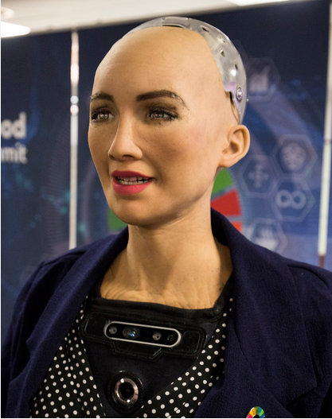
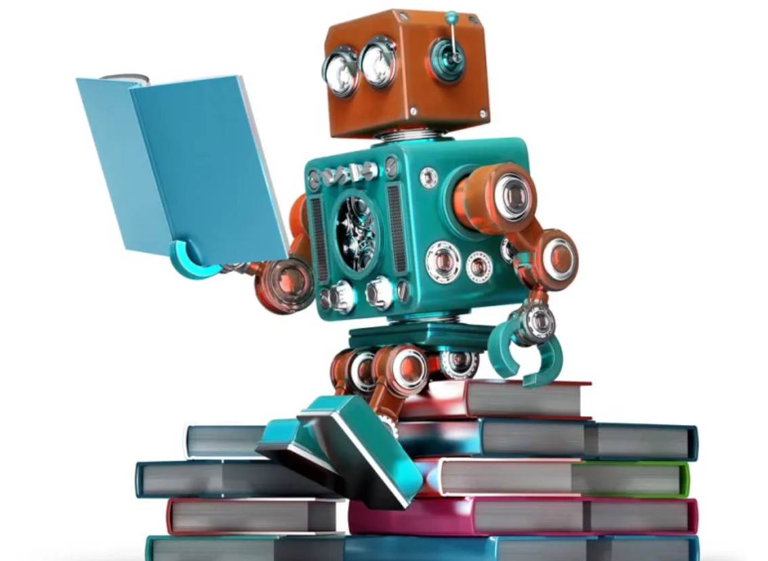
2016 – Hanson Robotics created the first “robot citizen,” Sophia, a humanoid robot capable of facial recognition, verbal conversation, and facial emotion.
2018: A Chinese tech group called Alibaba’s language-processing AI beat human intellect on a Stanford reading and comprehension test.
2020: OpenAI started beta testing GPT-3, a model that uses Deep Learning to create code, poetry, and other such language and writing tasks.
Notes:
The test generated questions about set of Wikipedia articles, where humans and AI programs were made to read a passage from over 500 Wikipedia articles and answered a series of questions regarding what they read.

Slide 7


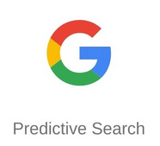






Notes:
Now we cannot imagine the day without using any of this tool, ChatGPt is product from Open AI, capable of understanding and generating human-like text based on the input they receive.Google uses AI in its predictive search. When you start typing on Google to search something, Google makes some recommendations. It uses past user data to predict what a user would type next in the search bar. Youtube uses past user data to recommend what movie a user might want to see next, making the user hooked onto the platform and increasing watch time. AI is used everywhere by large organizations to make an end user’s life simpler. Now let’s understand how all this tool learns and related with information technology

Slide 8
How all this tools Learns
Problem Definition and Understanding :Define clear objectives and success criteria for the project
Data Collection: The learning process starts with collecting relevant data. This data could be both structured (e.g., databases, spreadsheets) and unstructured data (e.g., text, images)
Data Preprocessing: Raw data is often noisy or contains irrelevant information. Data preprocessing involves cleaning and transforming the data to make it suitable for training.
Exploratory Data Analysis: Visualize the data using graphs, charts, and statistical summaries to understand its distribution, patterns, and relationships.
Notes:
It starts with Acquire both structured (e.g., databases, spreadsheets) and unstructured data (e.g., text, images) as required.
This may include handling missing values, normalizing data, and converting data into a format that the model can understand.

Slide 9
How all this tools Learns
Model Selection & Training: Choose appropriate machine learning algorithms based on the problem type (classification, regression, clustering, etc.).
Model Evaluation: Evaluate model performance using appropriate metrics (accuracy, precision, recall, F1-score, etc.) on the test set.
Deployment: Once the model is trained and validated, it is deployed to make predictions on real-world data. This could involve integrating the model into a production system or using it as a standalone application.
All these requires strong backend infrastructure for data storage, communication, processing, user interface. And also, now possible due to advancements in IT industry.
Notes:
No matter how good the AI model if not deployed properly in will be no use. Like In supermarket you have created code for software recommendation and future demand when user is raising the request for product that time only should the stock level, future demands, and recommended products. Otherwise it will not be use also it has be quick it not like after an hour we provide. Currently in Bosch I am working in Anomaly detection production, we have to proactively detect failures in production line to avoid production downtime. It is done using showing the abnormal behaviour in stations, could be abrut shift in measurements values, gradual change or bunching of outliers near the threshold. It also has be quick, It has only possible due to advancements in Information technology. Will Highlight the advancement which are making AI products successful.
It's important to note that the learning process is iterative. If the model's performance is not satisfactory, the process may be repeated with additional data, adjustments to the model, or changes to the learning approach. The continuous learning and improvement over time are key characteristics of machine learning and AI systems.

Slide 10
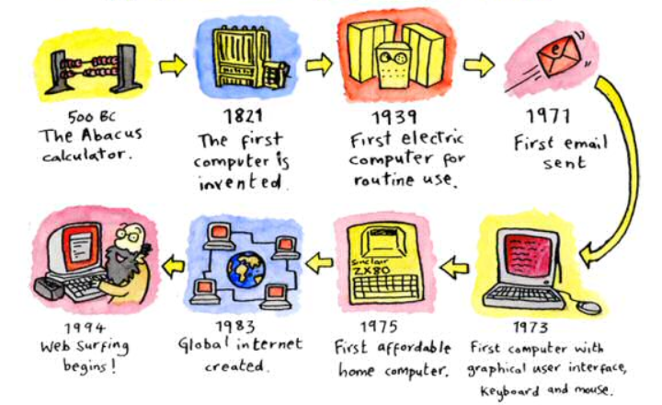
Notes:
During the first generation, computer systems used vacuum tubes. The machines were huge and took up entire rooms. They consumed a large amount of electricity and therefore, were expensive to operate. They also generated a lot of heat which resulted in malfunctions.
In the second generation, vacuum tubes were replaced with transistors. This was a major improvement, allowing computers to become smaller, faster, cheaper, reliable and more energy-efficient.
By the time the third generation arrived, there was an increase in the speed and the efficiency of computers due to the development of integrated circuits. Fourth generation computers upscaled to integrated circuits that contained a numerous amount of transistors on one, small chip. Microprocessors contained memory, logic and control circuits (central processing unit) on a single chip. Computer systems went from enormous vacuum tubes that filled an entire room to a tiny chip that could fit in your hand. Computers like IBM and Apple PC (personal computer) were created for both personal and business purposes. La

Slide 11
IT is Backbone
Since the invention of the world wide web, the IT realm has quickly expanded. When information technology started supporting artificial intelligence, it become easier to incorporate AI into business. Here are IT tools helping the AI world:
Storage capacity: AI heavily relies on large datasets for learning. IT infrastructure facilitates the storage, retrieval, and management of massive amounts of structured and unstructured data.
Computing performance : AI Requires high performance computing resources, including CPUs, GPUs, and TPU’s, Big data technologies, like Apache Spark and Hadoop, are crucial for handling and analyzing vast amounts of information.
Networking infrastructure: Fast and reliable networking infrastructure is crucial for data transfer between components also Reduced latency is essential for real-time AI applications (HTTP based RESTful API)
Notes:
High-Performance Storage: Fast and scalable storage solutions are essential for handling large datasets used in training machine learning models.
Distributed File Systems: Distributed file systems like Hadoop Distributed File System (HDFS) or cloud-based solutions enable efficient storage and retrieval of data.

Slide 12
IT is Backbone
Security: IT plays a critical role in ensuring the security of AI systems, protecting data, models, and user privacy.
User Interface : The design of AI user interfaces plays a crucial role in making complex technologies accessible, understandable, and user-friendly.
Monitoring and Maintenance : IT tools provide monitoring and logging capabilities for AI applications.
Cloud Computing : Cloud platforms (e.g., AWS, Azure, Google Cloud) provide scalable and on-demand computing resources. AI developers can leverage cloud services for data storage, processing, and deployment, reducing infrastructure management overhead.
Notes:
Auto-Scaling: The ability to dynamically adjust resources based on demand ensures optimal performance and cost efficiency.
Load Balancing: Distributing incoming network traffic across multiple servers prevents overload on individual components.

Slide 13
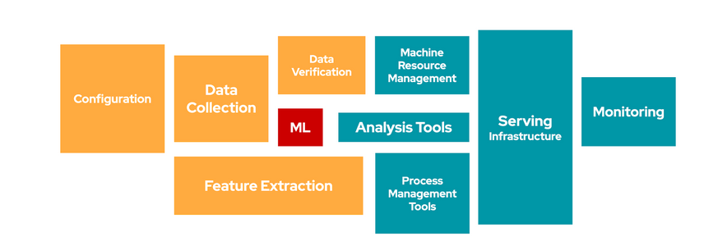
The Importance of Information Technology
Google, in its discussion Hidden Technical Debt in Machine Learning Systems, highlights that the actual ML is only a small element in an effective workflow. Success in delivering AI/ML requires a coordinated approach across a range of IT disciplines
Notes:
https://proceedings.neurips.cc/paper_files/paper/2015/file/86df7dcfd896fcaf2674f757a2463eba-Paper.pdf
Manufacturing, product recommendation, when placing the order pop up for optimized quantity to order resulting in inventory reduction, real time

Slide 14
AI now and in the future
Advances in artificial intelligence show no signs of slowing down - the world is changing rapidly, and as we move even further into an era dominated by artificially intelligent technology, the advancements in IT industry are important
While AI is powering its way into the present and future of computing technologies, there are still significant challenges to overcome.
And major part of it goes to setting up an infrastructure where you can run AI tools. Only after building a robust AI infrastructure, the benefits of AI and ML models can be reaped.
Notes:
, processing thousands of terabytes of data on a daily basis to build predictive models of consumer behavior. It has already made their way into everyday life, helping us save time and energy.

Slide 15
AI now and in the future
Tech giants such as Google, Meta and Amazon, have been utilizing machine learning to make constant advancements and successful as they have infrastructure for data storage, processing, modelling, Monitoring and Response time.
But still for lot of companies, to use AI setting up the right infrastructure is challenge.
This is where I think, IT engineers can help companies in setting up the right infrastructure
Notes:
Today, for all the successful products like ChatGPT, Weather Forecasting, Smart Replies, or Smart Recommendation, backbone is best infrastructure for data storage, processing, modelling, Monitoring and Response time.

Slide 16
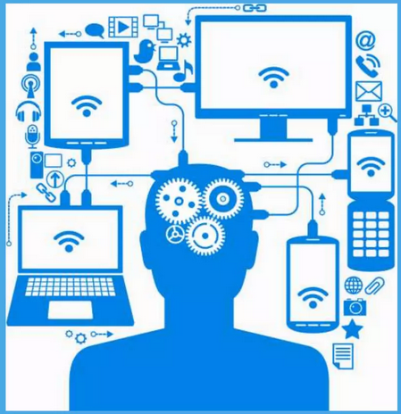
IT can exist without AI but
AI can’t exist without IT

Slide 17


Slide 18
Career
Tech careers are considered one of the fastest-growing professions. A degree in Information technology is of good value since it has a very high return on investment.
Information technology has made a major impact in our lives. Today there is hardly any field which is not benefited by computers. It is helping every field to grow and develop.
It has led to creation of a number of job including computer programmers, data engineer, system analyst, software developer, web designer, Devops etc.

Slide 19
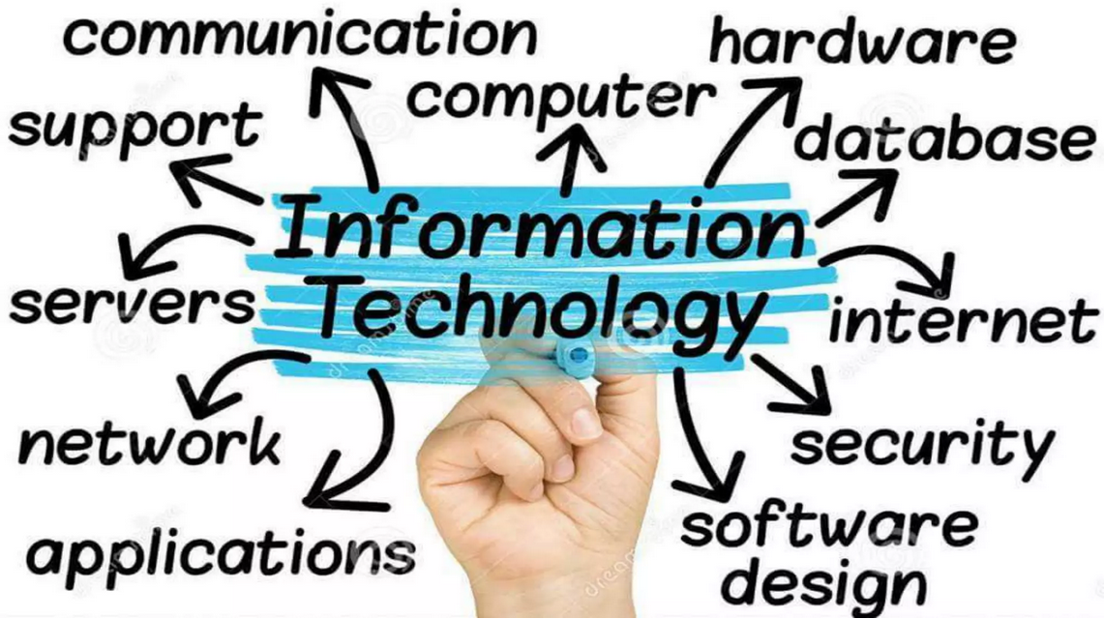
Xxxxxxxx gn5tyy7/^/56tygF ‘4321111~wwr54edfe4fffffffffffffffffffffffcdr

Slide 20
Thank You

Slide 21
Tim Berners-Lee introduced the World Wide Web, an "internet" that was a web of information retrievable by anyone, in 1991. In 1996, the Nokia 9000 Communicator became the world's first internet-enabled mobile device. By this time, the world's first search engine, the first laptop computer and the first domain search engine were already available. In the late '90s, search engine giant Google was established.
Since the invention of the world wide web, the IT realm has quickly expanded. Today, IT encompasses tablets, smartphones, voice-activated technology, nanometer computer chips, quantum computers and more

Slide 22
Why AI is Booming Today?
Fourier Transform was first discussed in 1805. It’s a mathematical function that transforms a signal from the time domain to the frequency domain. It is a very powerful transformation that gives you the ability to understand the frequencies inside a signal.
However, due to the lack of in-depth computational tools, scientists could not explore it further (until ~1970) or use it in any commercial systems. But now, it’s widely used in image processing and signal processing in many commercial and critical systems (including RADAR & SONAR).

Slide 23
Prerequisites
And all these applications are only possible to due to advancements in IT solution. It is just beginning, there’s so much more to come.

Slide 24
AI product is Everywhere
In online shopping, web searches, making translations, chatbots, cars, transportation, smart homes and cities, cybersecurity, healthcare sector, agriculture and farming, finance, e-commerce, etc.
Companies benefit from AI to automate their warehouses and better manage their supply chain
Since e-commerce is growing and becoming more and more common, firms invest heavily on digitalization and e-commerce.
In healthcare sector, machines are used for diagnosis of diseases and monitoring the health of patients.
Notes:
Machine Learning: ML teaches a machine how to make inferences and decisions based on past experience. This automation saves human time for businesses and helps them make a better decisions.
Natural Language Processing: NLP is a science of reading, understanding, and interpreting a language by a machine. Once a machine understands what the user intends to communicate, it responds accordingly.
Computer Vision: Computer vision algorithms try to understand an image by breaking down an image and studying different parts of the object. This helps the machine classify and learn from a set of images, to make a better output decision based on previous observations.

Slide 25
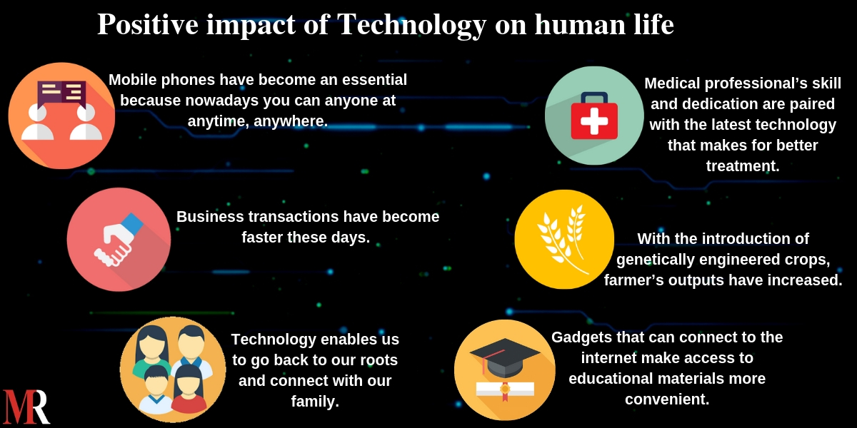
Notes:
https://blog.mirrorreview.com/impact-of-technology-on-human-life/

Slide 26
As we see above year on year new transformations have happened which have helped the AI industry to come this far and establish itself. Over the next few years, we expect AI to better itself and bring radical changes in the way industries function.

Slide 27
When we think of information technology (IT), we think of computers and the internet. Right? Even kids can´t imagine that there was a time without computers, cell phones and other mobile devices. We use it everyday and we feel that we can´t live without it.

Slide 28
Since the invention of the world wide web, the IT realm has quickly expanded.

Slide 29
Information technology is no longer just about installing hardware or software, solving computer issues, or controlling who can access a particular system.
Since the invention of the world wide web, the IT realm has quickly expanded.
Today's IT sector is no longer the exclusive domain of mathematicians. It employs professionals from a variety of backgrounds and skillsets, such as network engineers, programmers, business analysts, project managers and cybersecurity analysts.

Slide 30
Cloud computing, first invented in the 1960s, is now an inseparable part of many organizations' IT strategies.
But it wasn't until 2006 and the creation of Amazon Web Services (AWS) that cloud computing really took off. The top three providers -- AWS, Google and Azure -- accounted for 58% of the total cloud spending in the first quarter of 2021.
The invention of email in the 1970s revolutionized IT and communications. Email began as an experiment to see if two computers could exchange a message, but it evolved into a fast and easy way for humans to stay in touch.

Slide 31
artificial intelligence is a branch of computer science which endeavors to replicate or simulate human intelligence in a machine, so machines can perform tasks which typically require human intelligence.
Artificial Intelligence is the ability of computer systems to mimic human intelligence. Machine learning, a subset of artificial intelligence, deals with how machines learn like humans by analyzing data. More data and experience lead to better machine learning and better outputs.
Statistics indicates that the use of AI in various sectors has increased by 270% over the previous four years.
AI is practically every wherein our lives. SIRI, Google Assistant, Alexa, Google Maps, Google Translate, Google’s predictive searches, face verification on smartphones, autopilot feature of cars can be given as examples.

Slide 32
Furthermore, we can see AI in different sectors such as finance, healthcare, social media. Statistics indicates that the use of AI in various sectors has increased by 270% over the previous four years.
IBM Watson is an AI technology for businesses and it is designed to answer questions asked in natural language. IBM Watson is used innumerous sectors. To illustrate, IBM Watson Health is used in making of new medicines, arranging patient appointments, clinical and medical research in health care sector. AI and machine-based learning are used in social media platforms too. Twitter uses AI to filter out hate speech and terroristic languages in tweets and Facebook uses AI inface verification to tag your friends. Together with Facebook and Twitter,Google uses AI in its predictive search. When you start typing on Google to search something, Google makes some recommendations for you to select. Google is able to do this thanks to the data it collects from you like your age,personal info, location, etc.
The importance of artificial intelligence today is obvious but what about the future?Will AI help us for a better future? The answer is yes. Thanks to technological enhancements and studies on AI, there’s no doubt that it will make humans live a better and more qualified life in the future. It will help humans to use their time more efficiently.
https://www.formica.ai/blog/brief-history-of-ai-artificial-intelligence

Slide 33
Over the past decade, other technological advancements have also influenced the world of IT. This includes developments in:
social media
internet of things
artificial intelligence
robotic process automation
big data
mobile computing -- in both devices and communications technologies such as 4G and 5G
Notes:
https://www.techtarget.com/whatis/feature/A-brief-history-of-the-evolution-and-growth-of-IT

Slide 34
Advantages of Artificial Intelligence (AI)
Reduction in human error
Available 24×7
Helps in repetitive work
Digital assistance
Faster/ Rational Decision Maker
Medical applications
Improves Security
Efficient Communication

Slide 35
Prerequisites for Artificial Intelligence
A strong hold on Mathematics – namely Calculus, Statistics and probability.
A good amount of experience in programming languages like Java, or Python.
A strong hold in understanding and writing algorithms.
A strong background in data analytics skills.
A good amount of knowledge in discrete mathematics.

Slide 36
Getting certified in AI will give you an edge over the other aspirants in this industry.
With advancements such as Facial Recognition, AI in Healthcare, Chat-bots, Virtual assistants, Self-driving cars, climate change prediction now is the time to build a path to a successful career in
Artificial Intelligence. have already made their way into everyday life, helping us save time and energy.
AI can help reduce and predict the risks of climate change, allowing us to make a difference before it’s too late. And all these applications are only possible to due to advancements in IT solution. It is just beginning, there’s so much more to come.

Slide 37
Role of IT in Business
Application Integration: IT collaborates with software development teams to seamlessly integrate ML capabilities into user interfaces and applications.
Continuous Integration and Deployment (CI/CD): IT employs CI/CD pipelines to automate the testing, integration, and deployment of ML models, ensuring a smooth transition from development to production.

Slide 38
Role of IT in Business
Companies are increasingly adopting artificial intelligence, as it helps them reduce human error, cut repetitive tasks, and predict demand. Information Technology is the main driver behind this innovations.
Scalable Resources: IT provides the necessary infrastructure and cloud services for deploying ML models, ensuring scalability to handle varying workloads.
Integration with Data Warehouses: IT integrates ML models with data warehouses, enabling real-time access to relevant data for predictions and insights.
Model Security: Implementing security measures to protect deployed models from potential attacks or unauthorized access is a key responsibility of IT.

Slide 39


Slide 40
McKinsey Global Institute predicts annual $300 billion in savings by 2025 in the US healthcare system through IT integration.
86% of banks believe technology is pivotal to their success in the next five years (PwC).
Global mobile phone market valuation exceeds $4 trillion in 2023.
Blockchain’s value in agriculture is projected to be $10.6 billion by 2025.
The global e-learning market is projected to reach $350 billion by 2025.
Connectivity between systems and networks is also on the rise. By 2030, there will be an estimated 500 billion devices connected to the internet, according to a Cisco report
All these are possible due to advancements in IT industry.

Slide 41
Imagine a world without computers and smartphones – what would we do? Millions of people wake up and go right to their phones or other digital devices to check their:
Text messages, Emails
Facebook, Other social media
Investments, Banking accounts
Perhaps you have been thinking about purchasing something and cannot wait to place the order. IT makes all this much easier than ever before and we are embracing it more each year.

Slide 42
When information technology supports artificial intelligence, it is much easier to start incorporating AI into your business. Here are some ways in which IT is helping the AI world:
Data storage and processing: AI requires large amounts of data to learn and improve. IT provides the necessary infrastructure for storing and processing this data.
Cloud computing: Cloud computing has made it easier to access and use AI tools and services. IT has made it possible to develop and deploy AI applications on the cloud.
Machine learning: Machine learning is a subset of AI that involves training algorithms to learn from data. IT provides the necessary tools and frameworks for developing and deploying machine learning models.
Natural language processing: Natural language processing (NLP) is a field of AI that deals with the interaction between computers and humans using natural language. IT provides the necessary tools and frameworks for developing and deploying NLP models.

Slide 43
The ability to collect data for training is of utmost value when competitors have no or limited access to data, or when it is difficult to obtain. Data enables businesses to train AI models and continuously re-train (improve) existing models.
Model Deployment
Next, the model is typically pushed to a runtime model-serving component, exposing the model using an HTTP based RESTful API, allowing intelligent applications to easily call the model for inference, adding value to those applications.
Monitoring, Validation
Post-deployment continuous analysis of model performance and behavior is critical. Visualization and alerting tools to highlight and inform on deviations over time are absolutely critical.
Notes:
https://cloud.redhat.com/blog/business-centric-ai/ml-with-kubernetes-part-4-ml/ops

Slide 44
How good the your Algorithm, results if not properly integrated in system/deployed becomes useless. IT provides the platform to support and deploy as application.
Machine Learning Engineer
Remote processing
Data Storage
Communication Infrastructure

Slide 45
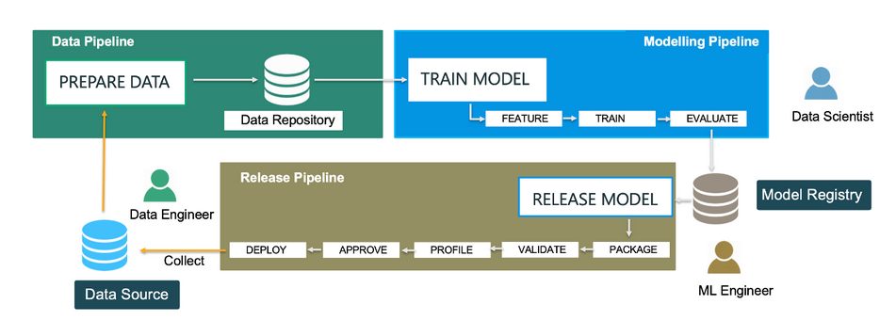

Slide 46
Information Technology is the main driver behind innovation, and without innovations, companies will not survive because they are the wave of the future. The digital revolution has created countless benefits for all businesses and kept them profitable. Virtually all businesses are recruiting IT applicants, with college degrees and some relevant industry experience.
here are several ways IT has improved American business and our economy, including:
Improved marketing and sales –Internet marketing has changed the way we buy and sell products and services. Most brick-and-mortar stores use this method to compensate for the lack of walk-in traffic.
Better decision-making and problem-solving – It is much easier to do marketing and management research online than by older methods. We find data and information faster and easier, analyze it, and make better plans. Innovative software allows us to also get faster and more accurate customer feedback.
Better control of resource management – IT helps businesses and industries operate more effectively and efficiently. Cloud computing is a major way to make this work by letting employees use devices anywhere they are to access their company’s software.
Notes:
https://iticollege.edu/blog/why-information-technology-is-so-important-today/

Slide 47
Role of IT in Business
Information Technology is the main driver behind innovation, and without innovations, companies will not survive because they are the wave of the future.
Scalable Resources: IT provides the necessary infrastructure and cloud services for deploying ML models, ensuring scalability to handle varying workloads.
Integration with Data Warehouses: IT integrates ML models with data warehouses, enabling real-time access to relevant data for predictions and insights.
Model Security: Implementing security measures to protect deployed models from potential attacks or unauthorized access is a key responsibility of IT.

Slide 48
Information Technology (IT) is the use of computers, storage, networking and other physical devices, infrastructure and processes to create, process, store, secure and exchange all forms of electronic data

Slide 49
Artificial Intelligence is a branch of computer science that was introduced with the idea to make things simpler and automotive which humans can’t (in most cases). The algorithm fits in artificial intelligence to learn from the provided data so that future predictions can be made for effective business.

Slide 50
Companies are increasingly adopting artificial intelligence, as it helps them reduce human error, cut repetitive tasks, and predict demand. And for most of them, it has become an integral part of their operations. While AI is powering its way into the present and future of computing technologies, there are significant challenges to overcome. And major part of it goes to setting up an infrastructure where you can run AI tools. Only after building a robust AI infrastructure, you can reap the benefits of AI and ML models. Today, for all the successful products like ChatGPT, Weather Forecasting, Smart Replies, or Smart Recommendation, backbone is best infrastructure for data storage, processing, modelling, Monitoring and Response time.

Slide 51
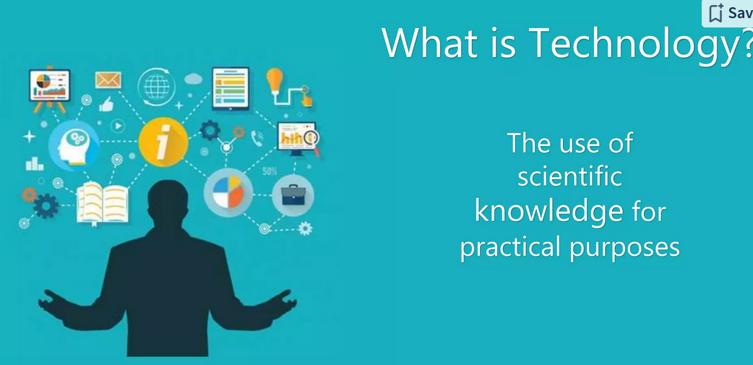

Slide 52
Task Automation: IT has enabled the automation of routine, repetitive tasks, freeing up human workers to focus on more complex and creative aspects of their roles.
Collaboration Tools: IT tools and platforms enable seamless communication and collaboration among remote teams, facilitating flexible work arrangements.
Big Data Analytics: IT enables the collection and analysis of large volumes of data, empowering organizations to make data-driven decisions for improved efficiency and competitiveness.
Security Measures: IT plays a crucial role in developing and implementing cybersecurity measures to protect sensitive data and systems.

Slide 53
E-commerce and Online Services: IT facilitates the shift toward digital business models, enabling online sales, customer interactions, and service delivery.
Online Learning Platforms: IT supports the development of online learning platforms, allowing employees to acquire new skills and stay updated on industry trends.

Slide 54
IT professionals work in roles such as system administrators, network engineers, software developers, data analysts, cybersecurity experts, and more, contributing to the development, implementation, and maintenance of IT systems across various industries.

Slide 55
